Slide 1
DEPARTMENT OF INTERNET OF THINGS AND ROBOTICS ENGINEERING (IRE)
UNIVERSITY OF FRONTIER TECHNOLOGY, BANGLADESH (UFTB)
PLADICS
A Lightweight YOLO26n-Based Framework for
River-Surface Plastic Waste Detection and Collection
Course : IRE 300 -Capstone Project
TEAM MEMBER
TEAM MEMBER
SUPERVISED BY
Mst. Esat Jahan Akhi
Jannatul Ferdushi Ayesha
Suman Saha
ID: 2201022
ID: 2201002
Assistant Professor, Dept. of IRE, UFTB

Slide 2
AGENDA
TABLE OF CONTENTS
01
02
03
04
Introduction
Problem & Motivation
Objectives
Literature Review
05
06
07
08
System Architecture
Detection Model & Results
Navigation, Collection & IoT
Demonstration & Conclusion
PLADICS | River-Surface Plastic Detection & Collection System
Overview
2

Slide 3
01 · INTRODUCTION
INTRODUCTION
RIVER PLASTIC POLLUTION
MANUAL COLLECTION IS COSTLY
NEED FOR AUTOMATION
Plastic debris entering rivers obstructs waterways, harms aquatic life, and fragments into persistent microplastics.
Manual inspection and cleanup of river surfaces require significant labor, time, and continuous operational effort.
Reflections, glare, vegetation, and water motion make automated river-surface plastic detection genuinely difficult.
PROPOSED SOLUTION — PLADICS
PLADICS (Plastic Detection and Intelligent Collection System) is a Raspberry-Pi-based rover that detects floating plastic with a lightweight YOLO26n model, tracks it with ByteTrack, and autonomously navigates to collect it using a conveyor-belt mechanism — with live IoT monitoring throughout.
Real-time Plastic Detection
Target Tracking (ByteTrack)
Autonomous Navigation
Conveyor-Belt Collection
IoT Telemetry Dashboard
PLADICS | River-Surface Plastic Detection & Collection System
Introduction
3

Slide 4
02 · PROBLEM & MOTIVATION
MOTIVATION
1
2
3
4
SCALE
LABOR
RELIABILITY
INTEGRATION
1,000+ rivers carry nearly 80% of ocean-bound plastic, making upstream interception highly valuable.
Continuous manual monitoring and removal of river debris is slow, expensive, and hard to scale.
Reflections, glare, vegetation, and water texture make plastic detection unreliable with simple vision methods.
Few systems connect detection with tracking, navigation, physical collection, and monitoring in one workflow.
GOAL
Build a lightweight, reproducible detection-to-collection framework that reliably finds river-surface plastic and physically removes it using a low-cost autonomous rover.
PLADICS | River-Surface Plastic Detection & Collection System
Motivation
4

Slide 5
03 · OBJECTIVES
OBJECTIVES
1
DATASET & DETECTION
2
MODEL SELECTION
Refine and merge public river-plastic datasets, then train a lightweight YOLO26n detector for real-time single-class plastic detection.
Compare YOLO, compact-CNN, and transformer detectors on accuracy, size, and CPU latency to choose a deployment-ready model.
3
NAVIGATION & COLLECTION
4
IoT MONITORING
Integrate ByteTrack-based target continuity with rule-based rover navigation and a conveyor-belt collection mechanism.
Stream live telemetry — detections, actions, and system health — to an MQTT / Node-RED dashboard for mission logging.
PLADICS | River-Surface Plastic Detection & Collection System
Objectives
5

Slide 6
04 · RELATED WORK
LITERATURE REVIEW
Research Area
Key Contribution
Lightweight YOLO for Water Surfaces [1]
Compact YOLOv5-based detector reduces computation for water-surface garbage detection.
Multiclass Surface Litter Detection [2]
SS-YOLOv8n targets multiclass floating litter with a lightweight backbone.
Multi-Scale Feature Fusion [3]
YOLOv8-MSS strengthens multi-scale representation for floating-waste detection.
Attention-Enhanced Detection [4]
Improved YOLOv7 adds fusion and attention modules for floating-debris localization.
Tracking-Assisted Detection [5]
YOLOv5 combined with DeepSORT maintains object identity across video frames.
Transformer-Based Detection [6]
RT-DETR-based models use global context for multi-scale floating-waste detection.
Complex-Scene Robustness [7]
Attention-enhanced YOLO variants improve detection under occlusion and clutter.
PLADICS | River-Surface Plastic Detection & Collection System
Literature Review
6

Slide 7
05 · SYSTEM ARCHITECTURE
SYSTEM ARCHITECTURE — END-TO-END WORKFLOW
1
2
3
4
5
6
Camera Input
YOLO26n Detection
ByteTrack Association
Target Selection
Navigation & Collection
IoT Dashboard
Pi Camera V2
captures live river-surface frames
Onboard NCNN inference
finds plastic candidates
Assigns persistent
track IDs across frames
Confidence + area +
alignment scoring
Motor + conveyor
actions via GPIO
MQTT telemetry to
Node-RED + CSV log
ONBOARD DEPLOYMENT DETAILS
Runs entirely onboard a Raspberry Pi 4 — YOLO26n exported to NCNN format for efficient edge inference.
Frames captured at 640×480 and processed at 416×416 inference resolution for real-time speed.
Rule-based control converts target position and box area into SEARCH / TURN / MOVE / STOP / COLLECT actions.
L298N motor driver handles drive motors; a GPIO relay activates the conveyor belt on a confirmed collection event.
PLADICS | River-Surface Plastic Detection & Collection System
System Architecture
7

Slide 8
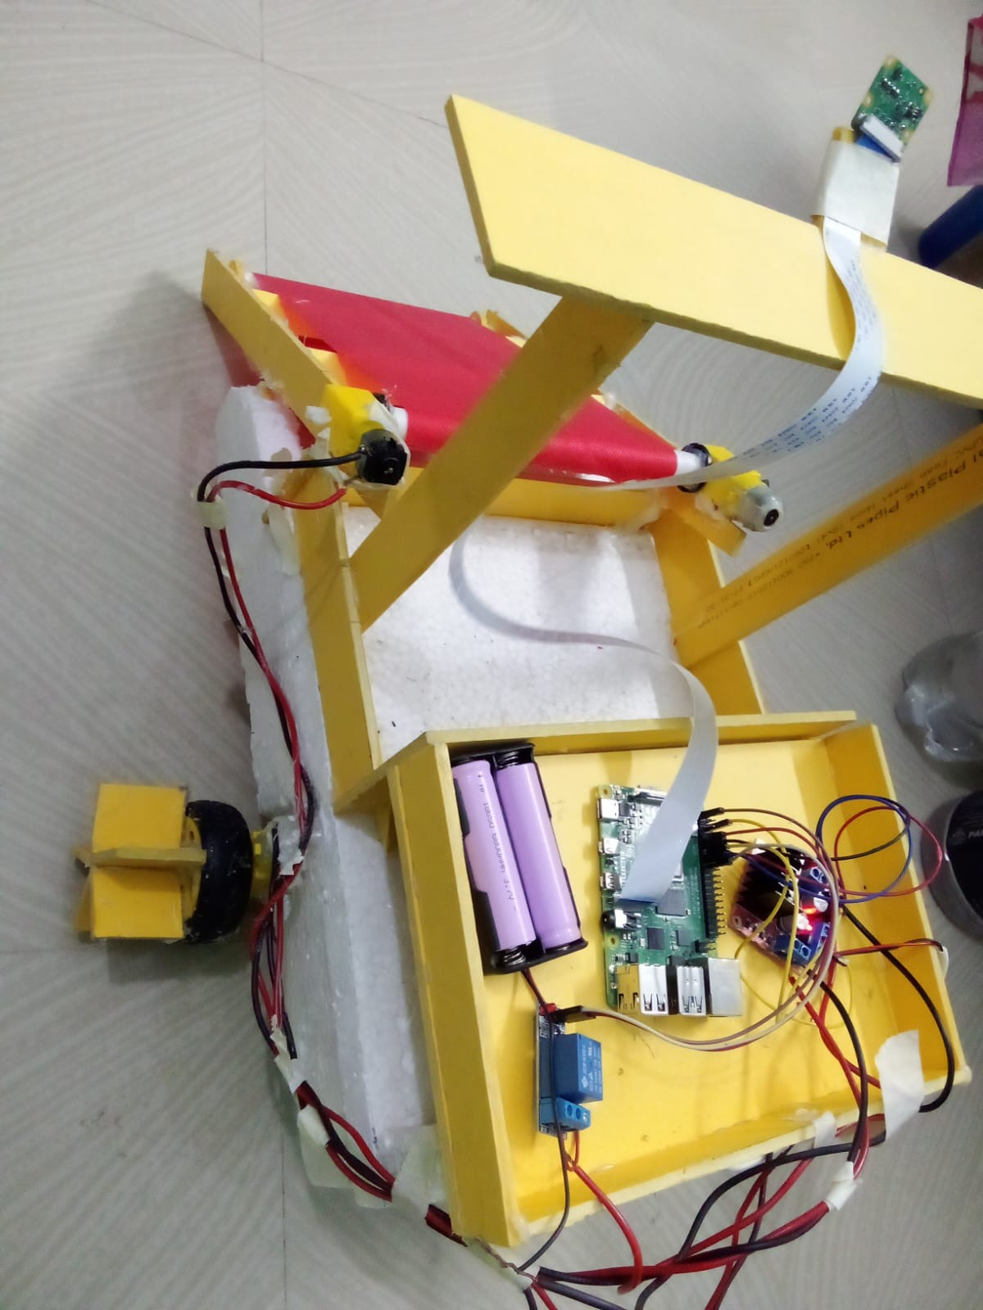
05 · SYSTEM ARCHITECTURE
HARDWARE STACK
Raspberry Pi 4
Onboard compute — runs YOLO26n (NCNN) detection, tracking, and control logic
Pi Camera Module V2
Captures 640×480 live video of the river / test surface
L298N Dual Motor Driver
Drives the left/right DC motors for rover navigation
Conveyor Belt + Relay
GPIO-triggered conveyor lifts detected plastic on board
Li-ion Battery Pack
Powers compute, motors, and conveyor mechanism
Foam & PVC Chassis
Lightweight buoyant frame housing all subsystems
Fig. A: Onboard electronics bay of the PLADICS prototype — Raspberry Pi 4, driver board, battery pack, conveyor motor, and camera boom.
PLADICS | River-Surface Plastic Detection & Collection System
Hardware Stack
8

Slide 9
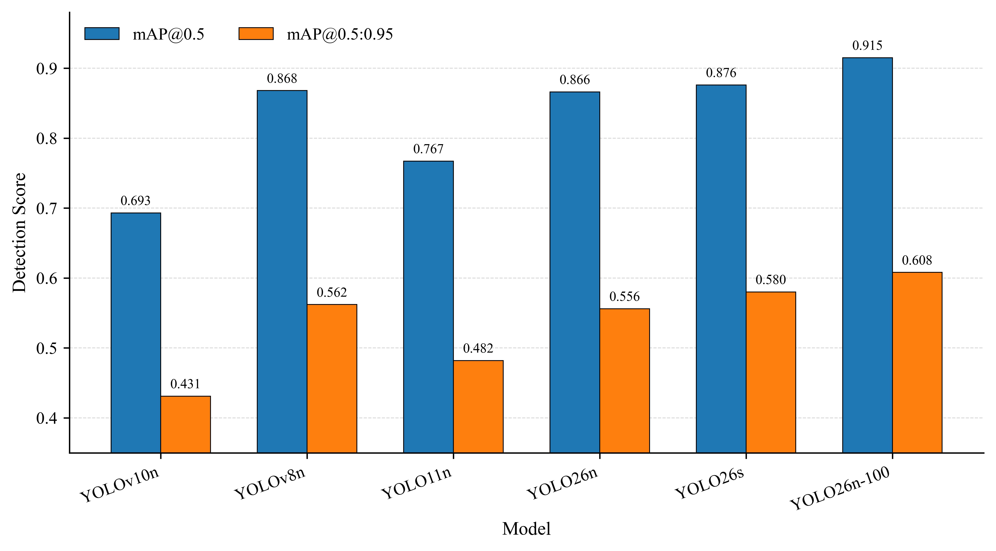
06 · DETECTION MODEL
DATASET PREPARATION & MODEL COMPARISON
7,264
refined images
(from 7,759 raw)
175
invalid boxes
removed
7
detectors
compared
Datasets: RiSID (7,356 imgs, 7 rivers) + Riverine Plastic Litter Dataset, merged and cleaned into a single-class “plastic” dataset (70:20:10 split).
Fig. 1: Detection accuracy of lightweight YOLO models on the cleaned single-class dataset (50-epoch benchmark).
PLADICS | River-Surface Plastic Detection & Collection System
Detection Model & Results
9

Slide 10
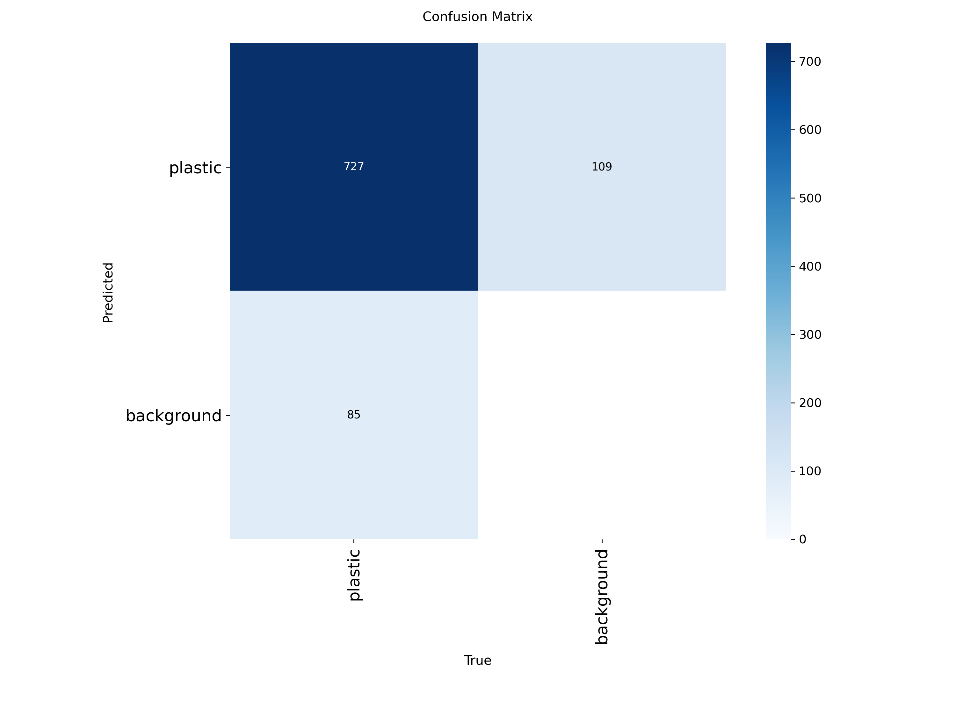
06 · DETECTION MODEL
SELECTED MODEL: YOLO26N — FINAL PERFORMANCE
0.919
0.844
0.915
0.608
2.38M params · 5.2 GFLOPs · 5.13 MB · 7.96 FPS (CPU)
Precision
Recall
mAP@0.5
mAP@0.5:0.95
WHAT THIS MEANS
727 of 812 true plastic instances were correctly detected on the held-out test set.
Extending training from 50 → 100 epochs raised mAP@0.5 from 0.866 to 0.915.
Remaining errors are mostly missed detections in reflective or cluttered scenes.
The 5.13 MB checkpoint is small enough to run comfortably on a Raspberry Pi 4.
Fig. 2: Confusion matrix of the 100-epoch YOLO26n model on the held-out test set.
PLADICS | River-Surface Plastic Detection & Collection System
Detection Model & Results
10

Slide 11
07 · NAVIGATION, COLLECTION & IOT
RULE-BASED NAVIGATION & COLLECTION CONTROL
SEARCH
TURN LEFT / RIGHT
MOVE FORWARD
STOP
COLLECT
No confirmed target — rover holds position and keeps scanning
Target off-center — steer toward the plastic's horizontal position
Target centered but still small — approach the target
Target's bounding-box area exceeds the stop threshold
Same target held stable for 4+ frames — conveyor runs for 5 s
Parameter
Meaning
Value
τacc
Minimum confidence to accept a candidate
0.40
Astop
Bounding-box area that triggers STOP
45,000 px
λL / λR
Left / right navigation-zone boundaries
0.33 / 0.66 × width
Ncol
Stable frames required before collection
4 frames
Tcool / Tconv
Collection cooldown / conveyor run time
5 s / 5 s
PLADICS | River-Surface Plastic Detection & Collection System
Navigation, Collection & IoT
11

Slide 12
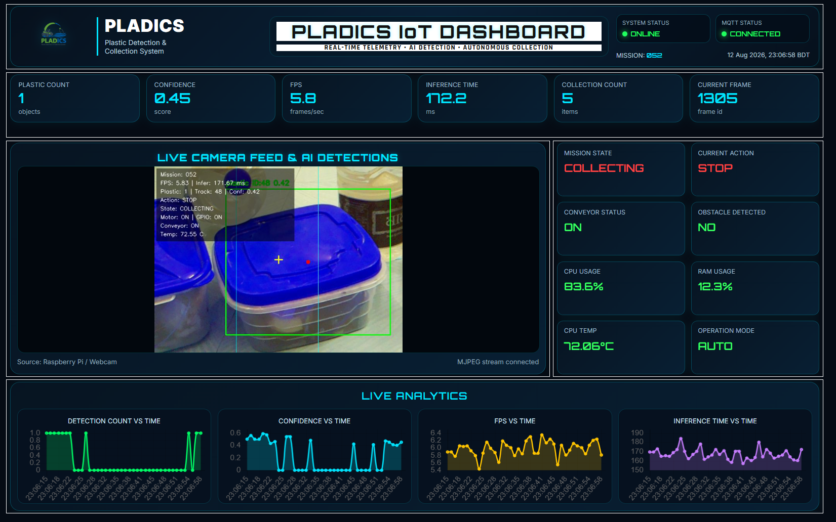
07 · NAVIGATION, COLLECTION & IOT
REAL-TIME IOT MONITORING
MONITORED PARAMETERS
Detection count & confidence
Active ByteTrack ID
Navigation action & mission state
Conveyor ON/OFF status
Inference time & frame rate
CPU / RAM / temperature
Broker: local Mosquitto (MQTT) → Node-RED dashboard. Every mission also writes a timestamped CSV log, and the annotated video stream is served live over Flask MJPEG.
Fig. 3: Live PLADICS IoT dashboard — plastic detected, tracked, and collection actively in progress.
PLADICS | River-Surface Plastic Detection & Collection System
Navigation, Collection & IoT
12

Slide 13
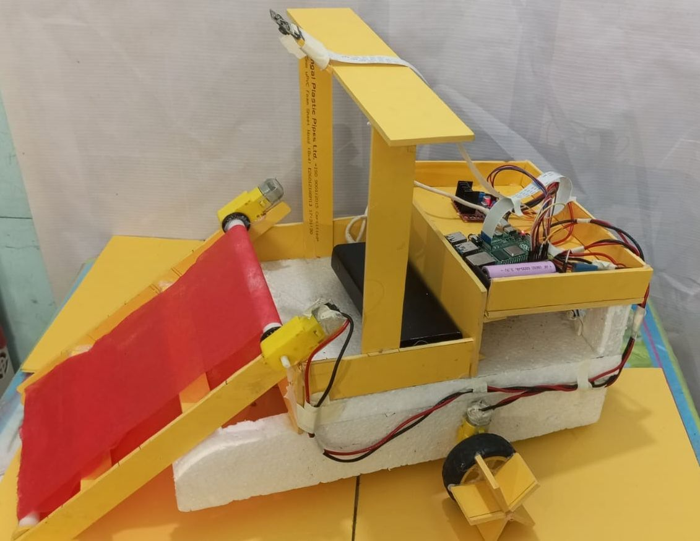
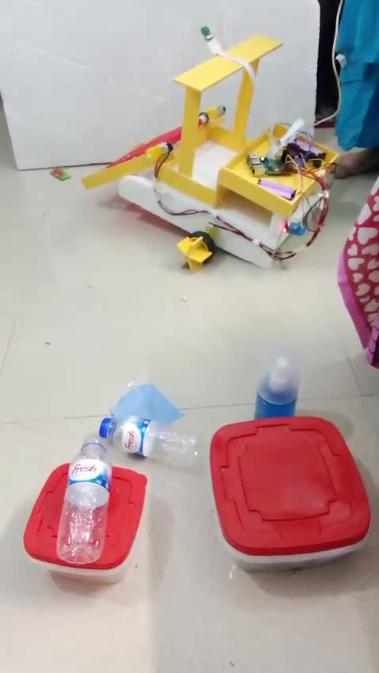
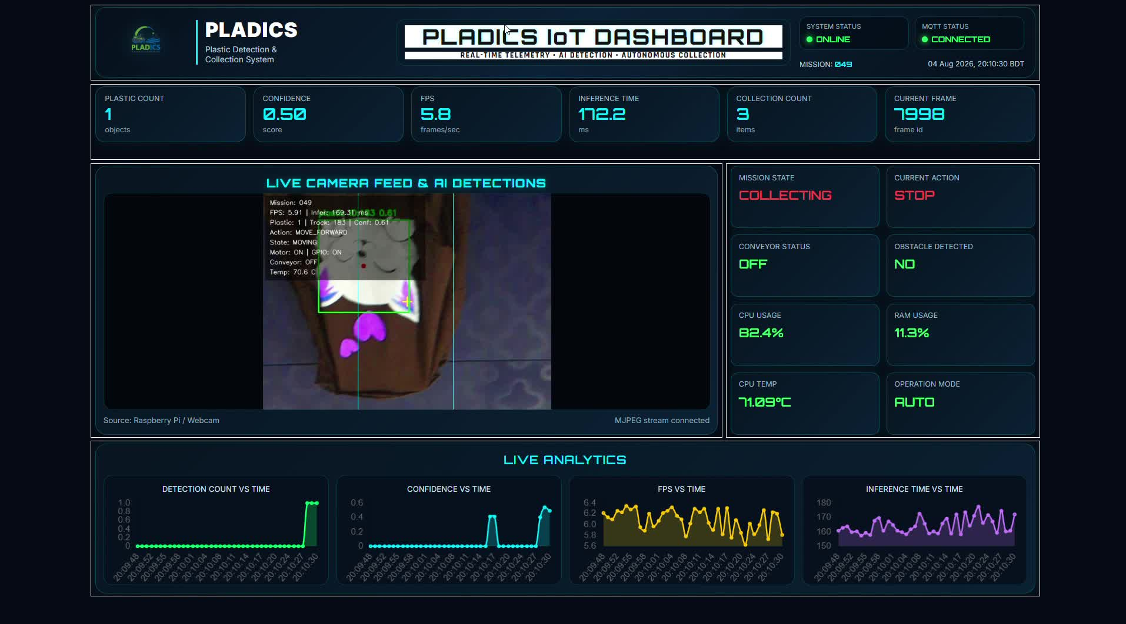
08 · DEMONSTRATION
SYSTEM DEMONSTRATION
Fig. 4: Assembled PLADICS rover — conveyor ramp, chassis, and onboard electronics bay.
Fig. 5: Live field trial — rover positioned in front of target plastic bottles during a test run.
Fig. 6: Dashboard view during a live run — plastic detected and tracked (Track ID 183, conf. 0.61).
PLADICS | River-Surface Plastic Detection & Collection System
Demonstration
13

Slide 14
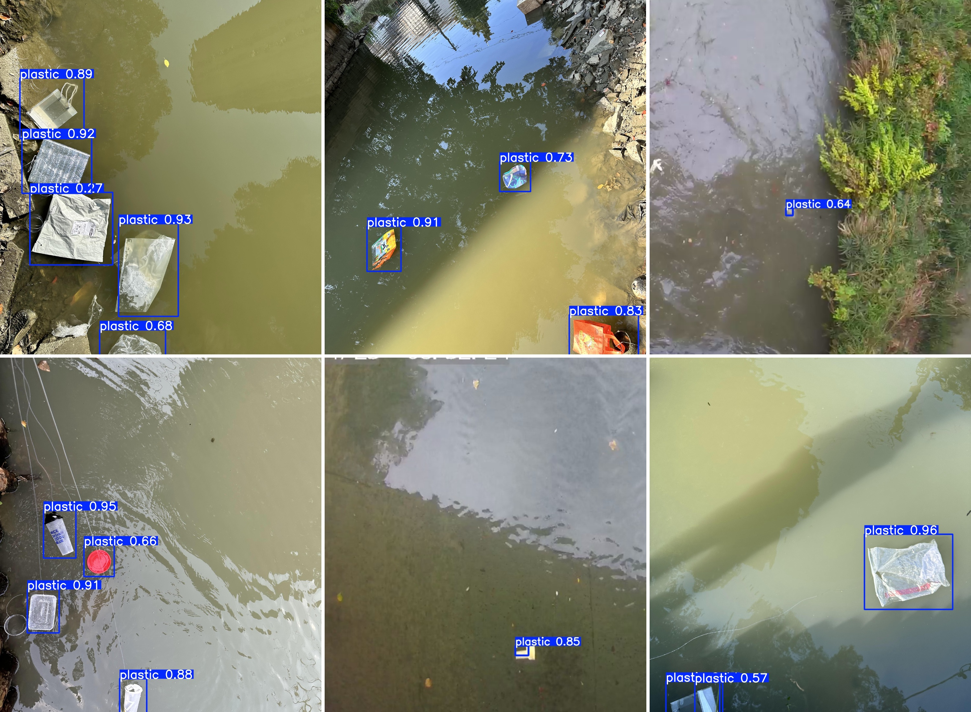
08 · DEMONSTRATION
QUALITATIVE DETECTION RESULTS
Fig. 7: YOLO26n detections on real river-surface test images — varying illumination, background, and object scale.
PLADICS | River-Surface Plastic Detection & Collection System
Demonstration
14

Slide 15
08 · DEMONSTRATION
RESULTS AT A GLANCE
91.5%
5.13 MB
7.96 FPS
7,264
mAP@0.5
(final model)
checkpoint size
(edge-deployable)
CPU inference
throughput
cleaned training
images
A single lightweight checkpoint powers detection, tracking, navigation, and collection — fully on board a Raspberry Pi 4.
PLADICS | River-Surface Plastic Detection & Collection System
Results
15

Slide 16
08 · DEMONSTRATION
CONTRIBUTIONS
DATASET
MODEL
Refined and merged a 7,264-image multi-source river-plastic dataset from RiSID and the Riverine Plastic Litter Dataset.
Selected and tuned a lightweight YOLO26n detector achieving 0.915 mAP@0.5 at just 5.13 MB.
INTEGRATION
MONITORING
Combined ByteTrack-based tracking with rule-based navigation and physical conveyor-belt collection.
Built a live MQTT / Node-RED IoT dashboard with mission-level CSV logging and MJPEG streaming.
PLADICS | River-Surface Plastic Detection & Collection System
Contributions
16

Slide 17
CONCLUSION
CONCLUSION & FUTURE WORK
FUTURE WORK
CONCLUSION
1
LARGER FIELD DATASETS
PLADICS demonstrates a complete, working detection-to-collection pipeline: a lightweight YOLO26n model detects river-surface plastic, ByteTrack keeps track of it, rule-based logic drives the rover and triggers the conveyor, and every mission is logged and streamed live to an IoT dashboard.
Collect river-specific data across seasons, cameras, and lighting.
2
OBSTACLE-AWARE NAVIGATION
Add sensing beyond rule-based logic for safer autonomous movement.
Proof-of-concept validated on a physical rover prototype
EXTENDED FIELD TRIALS
3
Validate long-term autonomous operation on real rivers, not test tanks.
Runs fully on board — no cloud dependency for inference
4
MULTI-CLASS SORTING
Detection, tracking, navigation & collection are all integrated
Separate collected plastic by type using the multiclass detection models.
PLADICS | River-Surface Plastic Detection & Collection System
Conclusion & Future Work
17

Slide 18
REFERENCES
REFERENCES
[1] L. Chen and J. Zhu, “Water surface garbage detection based on lightweight YOLOv5,” Scientific Reports, vol. 14, no. 6133, 2024.
[6] B. Sun, H. Tang, L. Gao, K. Bi, and J. Wen, “RTDETR-MARD: A multi-scale adaptive real-time framework for floating waste detection in aquatic environments,” Journal of Marine Science and Engineering, vol. 13, no. 5, p. 996, 2025.
[2] Z. Fan, Z. Qin, W. Liu, M. Chen, and Z. Qiu, “SS-YOLOv8: A lightweight algorithm for surface litter detection,” Applied Sciences, vol. 14, no. 9283, 2024.
[7] T. Zhou et al., “ESAK-YOLO: Multi-scale attention enhanced object detection for floating waste in complex water scenes,” Scientific Reports, 2026.
[3] J. Wang and H. Zhao, “Improved YOLOv8 algorithm for water surface object detection,” Sensors, vol. 24, no. 15, p. 5059, 2024.
[8] M. MacLeod, H. P. H. Arp, M. B. Tekman, and A. Jahnke, “The global threat from plastic pollution,” Science, vol. 373, no. 6550, pp. 61–65, 2021.
[4] C. Peng, B. He, W. Xi, and G. Lin, “Improved YOLOv7 algorithm for floating waste detection based on GFPN and long-range attention mechanism,” Wuhan University Journal of Natural Sciences, vol. 29, no. 4, pp. 338–348, 2024.
[9] L. J. J. Meijer, T. van Emmerik, R. van der Ent, C. Schmidt, and L. Lebreton, “More than 1000 rivers account for 80% of global riverine plastic emissions into the ocean,” Science Advances, vol. 7, no. 18, 2021.
[5] M. Nunkhaw and H. Miyamoto, “An image analysis of river-floating waste materials by using deep learning techniques,” Water, vol. 16, no. 10, p. 1373, 2024.
[10] G. Jocher, J. Qiu, M. Liu, S. Lyu, F. C. Akyon, and M. E. Kalfaoglu, “Ultralytics YOLO26: Unified real-time end-to-end vision models,” arXiv:2606.03748, 2026.
PLADICS | River-Surface Plastic Detection & Collection System
References
18

Slide 19
THANK YOU!!
Questions & Discussion

